Slide 1
Successful athletes
from Novo mesto
who took part in
the Olympic Games

Slide 2
IGOR PRIMC
Successful athletes from Novo mesto who took part in the Olympic Games
He was born on 8 January 1966 in Novo mesto.
He is a discus thrower.
His personal best throw is 64.79 metres.
He was the State Champion 33 times.
At the 2001 World Championship he finished eleventh.

Slide 3
IGOR PRIMC
Successful athletes from Novo mesto who took part in the Olympic Games
At the Mediterranean Games he won the gold medal in 1997, the silver in 2005 and he finished fifth in 2001.
He took part in the Olympic Games in 1996 and 2004 but unfortunately he didn’t qualify for the final round.

Slide 4
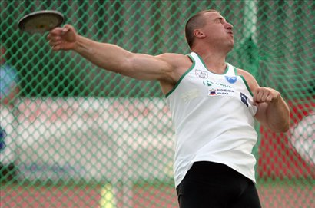
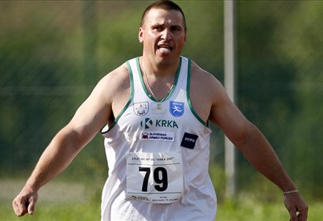
IGOR PRIMC
Successful athletes from Novo mesto who took part in the Olympic Games

Slide 5
JOŽE VRTAČIČ
Successful athletes from Novo mesto who took part in the Olympic Games
He was born on 1 February 1980 in Novo mesto, Slovenia.
He achieved his best result in 1997 when he competed at European Youth Olympic Days. He came third in long jump and he came second in relay run 4x100 metres.

Slide 6
JOŽE VRTAČIČ
Successful athletes from Novo mesto who took part in the Olympic Games
In 1999 he took part in the European Youth Championship in Riga, where he came fifth in running 200 metres.
In the Sydney Olympic Games in 2000 he took part in the relay event 4x100 metres.
Many times he was the State Champion.

Slide 7
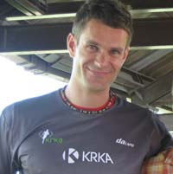
JOŽE VRTAČIČ
Successful athletes from Novo mesto who took part in the Olympic Games

Slide 8
BOŠTJAN ŠIMUNIČ
Successful athletes from Novo mesto who took part in the Olympic Games
Boštjan Šimunič, PhD, was born on 28 December, 1974, in Novo mesto, Slovenia.
He represented Slovenia at the Olympic Games in Athens in 2004 in triple jump. In the qualification round he came 37th.
His personal record is 16.82 metres.

Slide 9
BOŠTJAN ŠIMUNIČ – best results
Successful athletes from Novo mesto who took part in the Olympic Games
The European Cup - group B, Seville, Spain – triple jump (15.29, 0.0) – 3rd place - 1997
The European Cup - group B, Velenje, Slovenia –triple jump (15.44, +1.5) – 6th place - 1998
The European Athletics Indoor Championship, Gent, Belgium – triple jump - (16.21) – 17th place

Slide 10
BOŠTJAN ŠIMUNIČ – best results
Successful athletes from Novo mesto who took part in the Olympic Games
The Universiad, Beijing, China –triple jump (16.54, +0.2) – 7the place - 2001
The Mediterranean Games, Tunis, Tunisia – triple jump (16.34) – 4th place - 2001
The European Cup – group B, Budapest, Hungary – triple jump (15.12, +2.7) – 7th place - 2001

Slide 11
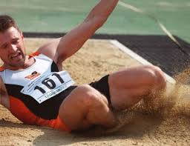
BOŠTJAN ŠIMUNIČ
Successful athletes from Novo mesto who took part in the Olympic Games

Slide 12
PRIMOŽ KOBE
Successful athletes from Novo mesto who took part in the Olympic Games
He was born on 23 May in 1981 in Novo mesto, Slovenia.
He started with long distance and marathon running in 2005.
In 2012 he ran in a marathon for Slovenia at the London Olympic Games.

Slide 13
PRIMOŽ KOBE
Successful athletes from Novo mesto who took part in the Olympic Games
His best results are:
1500m in 3:51
3000m in 8:23
5000m in 14:30
10000m in 30:11
half-marathon in 1:04:55
marathon in 2:14:50

Slide 14
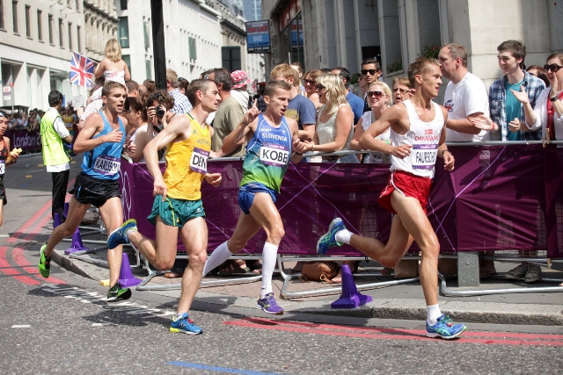
PRIMOŽ KOBE
Successful athletes from Novo mesto who took part in the Olympic Games

Slide 15
MAJA VTIČ
Successful athletes from Novo mesto who took part in the Olympic Games
She was born on 27 Januray 1988 in Novo mesto, Slovenia.
She is a ski-jumper.
In 2007 she won a bronze medal at the Junior Ski Jumping Championship.
She first took part in the World Championship in 2011 in Lillehammer where she came fifth.

Slide 16
MAJA VTIČ
Successful athletes from Novo mesto who took part in the Olympic Games
She won her first medal – bronze – in the World Championship competition in Hinzenbachu in 2014.
In the Sochi Olympic Games 2014 she came sixth.

Slide 17
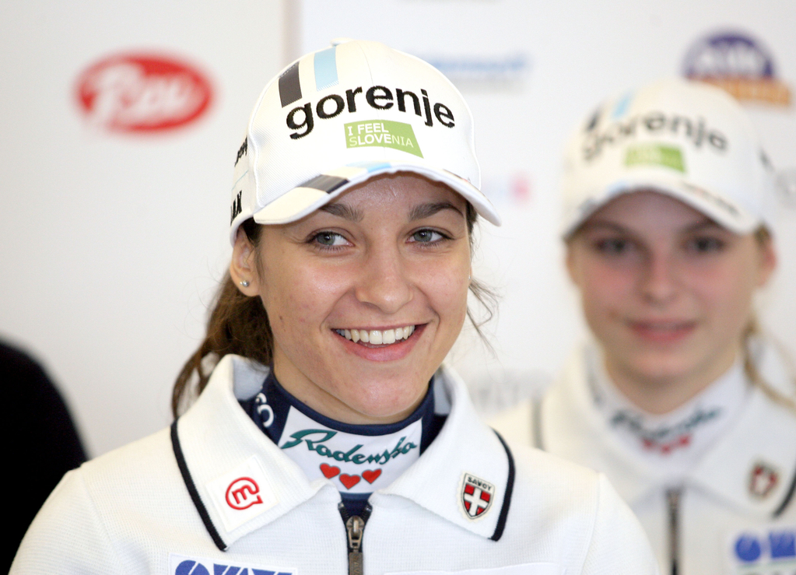
MAJA VTIČ
Successful athletes from Novo mesto who took part in the Olympic Games

Slide 18
SANDI PAPEŽ
Successful athletes from Novo mesto who took part in the Olympic Games
He was born on 25 February 1965, in Novo mesto, Slovenia.
He was a cyclist.
He rode his bike for then Yugoslavia at the summer Olympic Games in Seoul in 1988 where he came 15th in Men’s 100 km Team Time Trial.

Slide 19
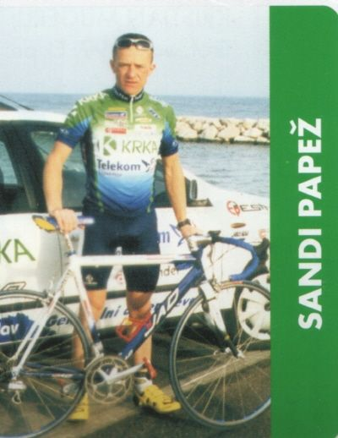
SANDI PAPEŽ
Successful athletes from Novo mesto who took part in the Olympic Games

Slide 20
LEON ŠTUKELJ
Successful athletes from Novo mesto who took part in the Olympic Games
Leon Štukelj of Slovenia was born only two years after the first modern Olympics and became the oldest living Olympic gold medalist.
He was born 12 November, 1898, in Novo mesto, Slovenia.
He was a gymnast.

Slide 21
LEON ŠTUKELJ
Successful athletes from Novo mesto who took part in the Olympic Games
Stukelj (pronounced SHTOO-kel) competed in three Olympics for Yugoslavia, of which Slovenia was then a part.
He won two gold medals in 1924, a gold and two bronzes in 1928 and a silver in 1936.
Then, at 37, after 6 Olympic and 14 world championship medals, he retired from gymnastics.

Slide 22
LEON ŠTUKELJ
Successful athletes from Novo mesto who took part in the Olympic Games
He became a judge and in time an Olympic hero for the ages.
His first Olympics, in 1924 in Paris, came a few weeks after he graduated from law school.
He won gold medals in the all-around and the horizontal bar, the first Olympic titles for Yugoslavia, then a new nation itself.
When he returned home, a national holiday was declared.

Slide 23
LEON ŠTUKELJ
Successful athletes from Novo mesto who took part in the Olympic Games
In the 1928 Olympics in Amsterdam, he won a gold medal in the rings and bronzes in the team and all-around competitions.
In the 1936 Berlin Olympics, an old man by gymnastics standards, he won a silver medal in the rings.

Slide 24
LEON ŠTUKELJ
Successful athletes from Novo mesto who took part in the Olympic Games
In 1997, when he was inducted into the International Gymnastics Hall of Fame in Oklahoma City, he was especially honoured because his class included such modern stars as Nadia Comaneci, Olga Korbut and Mary Lou Retton.

Slide 25
LEON ŠTUKELJ
Successful athletes from Novo mesto who took part in the Olympic Games
In 1996, he was a guest at the Atlanta Olympics.
https://www.youtube.com/watch?v=9mTD4E5Q2RY

Slide 26
LEON ŠTUKELJ – 1st right, frontline
Successful athletes from Novo mesto who took part in the Olympic Games

Slide 27
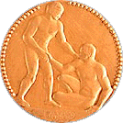
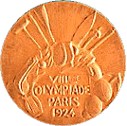
LEON ŠTUKELJ International competition Lyon 1926
Successful athletes from Novo mesto who took part in the Olympic Games

Slide 28
LEON ŠTUKELJ with Jesse Owens in olympic village, Berlin '36
Successful athletes from Novo mesto who took part in the Olympic Games

Slide 29
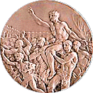
LEON ŠTUKELJ silver medal – Berlin 1936
Successful athletes from Novo mesto who took part in the Olympic Games

Slide 30
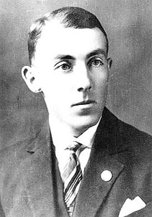
LEON ŠTUKELJ
Successful athletes from Novo mesto who took part in the Olympic Games

