Slide 1
Olympic Champions
from Slovenia

Slide 2
WINTER OLYMPIC GAMES
Olympic Champions from Slovenia
1984 – SARAJEVO - YUGOSLAVIA
PLACE | WHO | DISCIPLINE / EVENT
2nd | JURE FRANKO | alpine skiing- giant slalom

Slide 3
WINTER OLYMPIC GAMES
Olympic Champions from Slovenia
1988 – CALGARY - CANADA
PLACE | WHO | DISCIPLINE / EVENT
2nd | MATEJA SVET | alpine skiing- slalom
2nd | MIRAN TEPEŠ MATJAŽ ZUPAN PRIMOŽ ULAGA MATJAŽ DEBELAK | ski jumping - team
3rd | MATJAŽ DEBELAK | ski jumping – large hill

Slide 4
WINTER OLYMPIC GAMES
Olympic Champions from Slovenia
1994 – LILLEHAMMER- NORWAY
PLACE | WHO | DISCIPLINE / EVENT
3rd | KATJA KOREN | alpine skiing - slalom
3rd | JURE KOŠIR | alpine skiing – slalom
3rd | ALENKA DOVŽAN | alpine skiing - combined

Slide 5
WINTER OLYMPIC GAMES
Olympic Champions from Slovenia
2002 - SALT LAKE CITY - US
PLACE | WHO | DISCIPLINE / EVENT
3rd | PRIMOŽ PETERKA DAMJAN FRAS PETER ŽONTA ROBERT KRANJEC | ski jumping – team large hill

Slide 6
WINTER OLYMPIC GAMES
Olympic Champions from Slovenia
2010 – VANCOUVER - CANADA
PLACE | WHO | DISCIPLINE / EVENT
2nd | TINA MAZE | alpine skiing – super G
2nd | TINA MAZE | alpine skiing – giant slalom
3rd | PETRA MAJDIČ | cross-country skiing – women’s sprint

Slide 7
WINTER OLYMPIC GAMES
Olympic Champions from Slovenia
2014 – SOCHI - RUSSIA
PLACE | WHO | DISCIPLINE / EVENT
1st | TINA MAZE | alpine skiing - downhill
1st | TINA MAZE | alpine skiing – giant slalom
2nd | PETER PREVC | ski-jumping – normal hill
3rd | VESNA FABJAN | cross-country skiing – women’s sprint
3rd | TEJA GREGORIN | biathlon - pursuit
3rd | PETER PREVC | ski-jumping – large hill
3rd | ŽAN KOŠIR | snowboarding – parallel slalom

Slide 8
SUMMER OLYMPIC GAMES
Olympic Champions from Slovenia
1912 – STOCKHOLM - SWEDEN
PLACE | WHO | DISCIPLINE / EVENT
2nd | RUDOLF CVETKO | archery - team

Slide 9
SUMMER OLYMPIC GAMES
Olympic Champions from Slovenia
1916 – PARIS - FRANCE
PLACE | WHO | DISCIPLINE / EVENT
1st | LEON ŠTUKELJ | gymnastics – horizontal bar
1st | LEON ŠTUKELJ | gymnastics – all-around individual

Slide 10
SUMMER OLYMPIC GAMES
Olympic Champions from Slovenia
1928 – AMSTERDAM - NETHERLANDS
PLACE | WHO | DISCIPLINE / EVENT
1st | LEON ŠTUKELJ | gymnastics - rings
2nd | JOŽE PRIMOŽIČ | gymnastics – parallel bars
3rd | LEON ŠTUKELJ | gymnastics – all-around individual

Slide 11
SUMMER OLYMPIC GAMES
Olympic Champions from Slovenia
1936 – BERLIN - GERMANY
PLACE | WHO | DISCIPLINE / EVENT
2nd | LEON ŠTUKELJ | gymnastics - rings

Slide 12
SUMMER OLYMPIC GAMES
Olympic Champions from Slovenia
1952 – HELSINKI - FINLAND
PLACE | WHO | DISCIPLINE / EVENT
3rd | SONJA ROZMAN MILICA ROŽMAN ADA SMOLNIKAR | gymnastics – team portable apparatus

Slide 13
SUMMER OLYMPIC GAMES
Olympic Champions from Slovenia
1964 – TOKYO - JAPAN
PLACE | WHO | DISCIPLINE / EVENT
1st | MIRO CERAR | gymnastics – pommel horse
3rd | MIRO CERAR | gymnastics – horizontal bar

Slide 14
SUMMER OLYMPIC GAMES
Olympic Champions from Slovenia
1968 – MEXICO CITY - MEXICO
PLACE | WHO | DISCIPLINE / EVENT
1st | MIRO CERAR | gymnastics – pommel horse
2nd | IVO DANEU ALJOŠA ŽORGA | basketball

Slide 15
SUMMER OLYMPIC GAMES
Olympic Champions from Slovenia
1984 – LOS ANGELES – UNITED STATES
PLACE | WHO | DISCIPLINE / EVENT
1st | ROLANDO PUŠNIK | handball
1st | ALENKA CUDERMAN | handball
3rd | SREČKO KATANEC MARKO ELSNER | football

Slide 16
SUMMER OLYMPIC GAMES
Olympic Champions from Slovenia
1988 – SEOUL – SOUTH KOREA
PLACE | WHO | DISCIPLINE / event
2nd | JURE ZDOVC | basketball - men
2nd | POLONA DORNIK STOJNA VANGELOVSKA | basketball - women
3rd | SADIK MUJKIĆ BOJAN PREŠEREN | rowing- coxless pairs
3rd | ROLANDO PUŠNIK IZTOK PUC | handball - men

Slide 17
SUMMER OLYMPIC GAMES
Olympic Champions from Slovenia
1992 – BARCELONA - SPAIN
PLACE | WHO | DISCIPLINE / EVENT
3rd | DENIS ŽVEGELJ IZTOK ČOP | rowing – coxless pairs
3rd | SADIK MUJKIĆ MILAN JANŠA SAŠO MIRJANIČ JANI KLEMENČIČ | rowing- coxless fours

Slide 18
SUMMER OLYMPIC GAMES
Olympic Champions from Slovenia
1996 – ATLANTA – UNITED STATES
PLACE | WHO | DISCIPLINE / EVENT
2nd | BRIGITA BUKOVEC | athletics- 100m hurdles
2nd | ANDRAŽ VEHOVAR | canoe/kayak slalom

Slide 19
SUMMER OLYMPIC GAMES
Olympic Champions from Slovenia
2000 – SYDNEY – AUSTRALIA
PLACE | WHO | DISCIPLINE / EVENT
1st | RAJMOND DEBEVEC | shooting – 50m rifle 3 positions
1st | IZTOK ČOP LUKA ŠPIK | rowing – double scull

Slide 20
SUMMER OLYMPIC GAMES
Olympic Champions from Slovenia
2004 – ATHENS - GREECE
PLACE | WHO | DISCIPLINE / EVENT
2nd | IZTOK ČOP LUKA ŠPIK | rowing – double scull
3rd | JOLANDA ČEPLAK | athletics – running 800 m
3rd | VASILIJ ŽBOGAR | sailing - laser
3rd | URŠKA ŽOLNIR | judo –half middleweight

Slide 21
SUMMER OLYMPIC GAMES
Olympic Champions from Slovenia
2008 – BEIJING - CHINA
PLACE | WHO | DISCIPLINE / EVENT
1st | PRIMOŽ KOZMUS | athletics - hammer throw
2nd | SARA ISAKOVIČ | swimming – 200m freestyle
2nd | VASILIJ ŽBOGAR | sailing – laser
3rd | LUCIJA POLAVDER | judo – heavyweight
3rd | RAJMOND DEBEVEC | shooting – 50m rifle 3 positions

Slide 22
SUMMER OLYMPIC GAMES
Olympic Champions from Slovenia
2012 – LONDON – UNITED KINGDOM
PLACE | WHO | DISCIPLINE / EVENT
1st | URŠKA ŽOLNIR | judo - half middleweight
2nd | PRIMOŽ KOZMUS | athletics – hammer throw
3rd | IZTOK ČOP LUKA ŠPIK | rowing - double scull
3rd | RAJMOND DEBEVEC | shooting – 50m rifle prone

Slide 23
Olympic Champions from Slovenia
IVO DANEU
Ivo was born on 6th October 1937 in Maribor. He first started playing basketball For Polet Basketball Club in Maribor.
He retired in 1970 as the Champion of the Slovenian League and the Wold Champion

Slide 24
Olympic Champions from Slovenia
Ivo Daneu
- highlights
6 times Champion of the Yugoslavian League
209 appearances with the Yugoslavian National Team
participated in 3 Olympic Games (Rome 1960, Tokyo 1964 and Mexico 1968)
took part in 3 World Championships (Rio de Janeiro 1963, Montevideo 1967 and Ljubljana 1970)
- World Champion in Ljubljana 1970

Slide 25
Ivo Daneu
Olympic Champions from Slovenia
- Olympic Silver medalist in Mexico 1968
- 2 times Silver medalist in World Championships: Rio de Janeiro 1963 and Montevideo 1967
- 3 times Silver medalist in European Championships: Belgrade 1961, Germany 1965 and Italy 1969
- bronze medalist in the 1963 European Championship in Wroclaw
- Ivo Daneu mastered the hook shot and used this unstoppable weapon to regularly score even from as far as the 6-7 meter range

Slide 26
Olympic Champions from Slovenia
Miro Cerar
MIROSLAV CERAR was known for his mastery of the pommel horse. Born in 1937 in Ljubljana, the capital of Slovenia, Miroslav Cerar was destined to discover gymnastics and dominate Yugoslavian men's gymnastics for an astonishing 14 years.

Slide 27
Olympic Champions from Slovenia
Miro Cerar
Cerar was the all-around champion of Yugoslavia beginning as a Junior National Champion in 1956. He won the national championship 13 times, and he was honored as the best all-around athlete in Yugoslavia.

Slide 28
Olympic Champions from Slovenia
Miro Cerar
During the course of his international career, he won 21 European medals, including 10 golds, to go with his six World and two Olympic gold medals.

Slide 29
Olympic Champions from Slovenia
1958 WORLD CHAMPIONSHIPS Bronze Medalist - Pommel Horse
1962 WORLD CHAMPIONSHIPS Gold Medalist & World Champion: - Pommel Horse - Parallel Bars - Team
Miro Cerar

Slide 30
Olympic Champions from Slovenia
1964 OLYMPIC GAMES Gold Medalist & Olympic Champion: - Pommel Horse Bronze Medalist - Horizontal Bar
Miro Cerar

Slide 31
Olympic Champions from Slovenia
Miro Cerar
1970 WORLD
CHAMPIONSHIPS Gold Medalist &
World
Champion: - Pommel Horse
1968 OLYMPIC GAMES Gold Medalist & Olympic Champion: - Pommel Horse
1999 Inducted into the International Gymnastics Hall of Fame

Slide 32
Olympic Champions from Slovenia
Tina Maze
Tina Maze is the most successful female ski racer in Slovenian history with a career that culminated with two gold medals at the 2014 Winter Olympics. In Slovenia, she was awarded the title of the best female athlete of the year for 2005, 2010, 2011 and 2013, and her four Olympic medals tie her with rower Iztok Čop as the most successful athlete representing Slovenia at the Olympics.

Slide 33
Tina Maze
Olympic Champions from Slovenia
She has 23 wins all together. 13 in giant slalom, 3 in downhill, 1 in super-G, 3 in slalom, 3 in super combination and she stood on the winner's podium 68 times.
She has also won 3 titles (1 overall, 1 giant slalom, 1 super-G) in World Cup. She has also broken many world records, all in season 2012/13.

Slide 34
Olympic Champions from Slovenia
Two silver medals (giant slalom and super -G) in Vancouver in 2010 and two gold medals (downhill and giant slalom) in Sochi in 2014.
She also won 6 medals (2 gold and 4 silver) in the World Championships.
She got amazing 2414 points in female category and in grand total. She won in all disciplines in one season. She won four Olympic medals.
Tina Maze

Slide 35
Olympic Champions from Slovenia
Tina Maze
During preparations for the 2013 season she recorded her first song "My Way Is My Decision". The news of Tina Maze becoming a rock star was celebrity news in Slovenia and she received some attention in the foreign media, too.
It was released on 26 October, the day before the first race in Sölden. The music video has become the most viewed new video on YouTube by a Slovenian music artist as it reached over 400,000 views in less than 3 days, which is Slovenia's fastest growing video in the music business.

Slide 36
SARA ISAKOVIĆ
Olympic Champions from Slovenia
Sara was born on 9 June in Kranj, Slovenia.
Growing up she attended international schools, because she wanted to pursue studies in the US where she could combine both athletics and academics at a world class level.

Slide 37
SARA ISAKOVIĆ
Olympic Champions from Slovenia
She competed for Slovenia at the 2004 Summer Olympics in Athens, the 2008 Summer Olympics in Beijing, and the 2012 London Olympics.
In 2008 Beijing Olympics, at the
age of 20, she came 2nd in the
200 freestyle with the time of 1.54.97, being the second woman ever (behind Federica Pellegrini)
to brake the 1 min 55 sec mark.

Slide 38
SARA ISAKOVIĆ
Olympic Champions from Slovenia
She is the only swimmer in history to win an Olympic medal in swimming for Slovenia.

Slide 39
ROBERT KRANJEC
Olympic Champions from Slovenia
Robert is a ski jumper who has been competing since 1998. He won a bronze medal at the 2002 Winter Olympics in Salt Lake City in the Team Large Hill event. On 25 February 2012, he won the Ski-Flying World Championship and thus became the Slovenia's third World Champion in ski jumping and the first in ski flying. He also set a new national record.

Slide 40
ROBERT KRANJEC
Olympic Champions from Slovenia
His first victory in a World Cup competition was at Kuusamo, Finland in 2005. In 2010 he celebrated his second World Cup victory at Tauplitz, Austria. After two more successful ski flying competitions at Tauplitz and Obersdorf, in which he achieved the second place each time, he won the ski flying World Cup 2009/10.

Slide 41
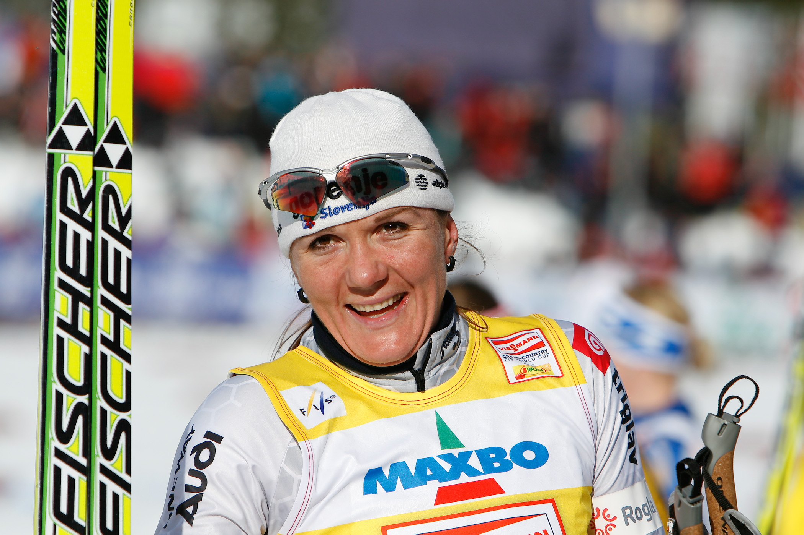
Olympic Champions from Slovenia
PETRA MAJDIČ
Petra Majdič (born 22 December 1979 in Ljubljana) is a Slovenian former cross-country skier.

Slide 42
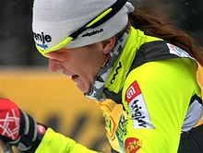
PETRA MAJDIČ
Olympic Champions from Slovenia
Her best results came in classic style races.
She won twenty-four World Cup races, twenty in sprint races, but she also won a marathon (30 km race) in Trondheim in 2009.

Slide 43
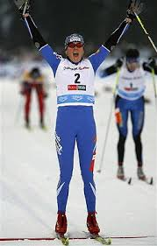
PETRA MAJDIČ
Olympic Champions from Slovenia
She is the first Slovenian cross-country skier to win the World Cup race, the first to get a medal at the World Championships and the first to get an Olympic medal.
With 20 wins, Majdič is the second-most successful sprinter in FIS Cross-Country World Cup history and with 24 wins in total she's the fourth-most successful World Cup competitor of all time.

Slide 44
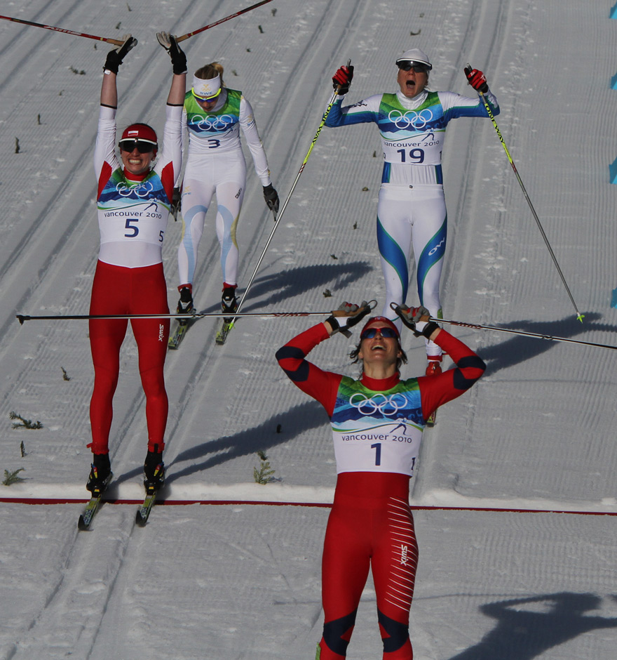
PETRA MAJDIČ
Olympic Champions from Slovenia
At the 2010 Olympics she finished third to win the bronze medal, the first individual Winter Olympic medal for Slovenia in 16 years.
Two days after the race she was awarded with the Golden Order for Services by the President of Slovenia Danilo Türk.
On 11 January 2011, she was proclaimed the Slovenian Woman of the Year for 2010.

Slide 45
RAJMOND DEBEVEC
Olympic Champions from Slovenia
He born March 29, 1963 in Postojna, Yugoslavia. He is a Slovenian shooter. He has won three Olympic and five World Championship medals in shooting. He also holds the world record for the 50 metre rifle three positions event.

Slide 46
RAJMOND DEBEVEC
Olympic Champions from Slovenia
He won his first medal in 1980 by participating in the Junior European Championships. He represented Yugoslavia at the Olympic Games in 1984 and 1988, and Slovenia in 1992, 1996, 2000, 2004, 2008, and 2012. He won gold at the 2000 Summer Olympics in Sydney, where he competed in the event 50 metre rifle three positions.

Slide 47
RAJMOND DEBEVEC
Olympic Champions from Slovenia
Debevec holds the world record for 50m rifle three position with 1186 points, which he set in Munich at the World Cup Final in 1992. He also holds the Olympic record (1177 points) for the same event, which he set during his gold medal-winning performance at the2000 Summer Olympics in Sydney.

Slide 48
LUKA ŠPIK and IZTOK ČOP
Olympic Champions from Slovenia
Luka Špik and Iztok Čop were both born in Kranj, Slovenia and they are Slovenian rowers and Olympic gold medallists.

Slide 49
LUKA ŠPIK and IZTOK ČOP
Olympic Champions from Slovenia
At the 2005 World Championship, they won gold in the Double Sculls event.
Luka and Iztok won the 1999 World Championship, and also the gold at the 2000 Sydney Olympics, which was the first Olympic gold medal for independent Slovenia.
Špik and Čop were the favourites to win the Men's double sculls at the 2004 Summer Olympics, but they finished in silver medal position.

Slide 50
LUKA ŠPIK and IZTOK ČOP
Olympic Champions from Slovenia
Coming into the 2012 Summer Olympics in London they were not the favourites, however with a strong performance in the semi-finals they announced they could be in the running for a medal. In the final of the Men’s double sculls, after taking an early lead and holding it until nearly the 1500m mark, they lost the lead to the Italians and the later winners from New Zealand. They finished in the third position thus winning a bronze medal for Slovenia.

Slide 51
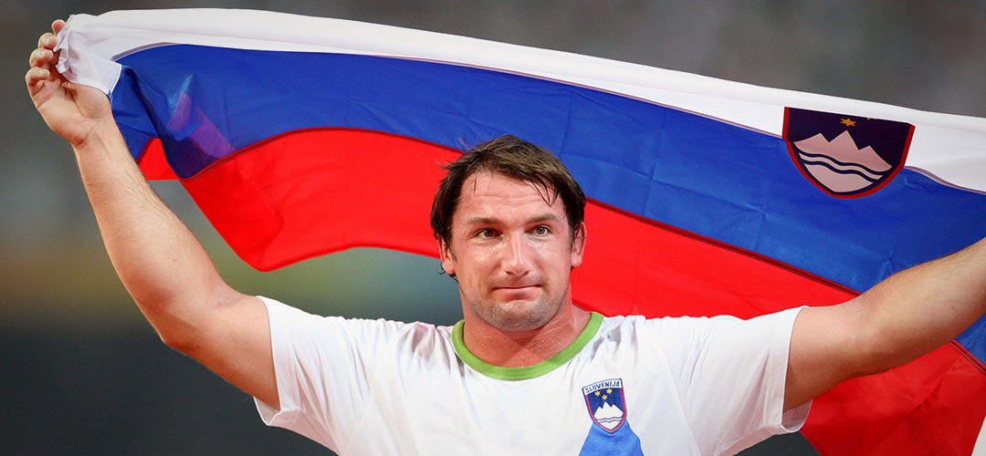
PRIMOŽ KOZMUS
Olympic Champions from Slovenia
Primož Kozmus (born September 30, 1979 in Novo mesto) is a Slovenian hammer thrower. His gold medals in the 2008 Summer Olympics in Beijing and the 2009 World Championships in Berlin made him the first ever Slovenian athlete to win both titles.

Slide 52
PRIMOŽ KOZMUS
Olympic Champions from Slovenia
His personal best throw and the Slovenian record is 82.58 metres, achieved in September 2009 in Celje, Slovenia.
After moderate achievements in the 2011 season, Kozmus proved he was a top athlete by winning a silver medal at the 2012 London Olympic Games.

Slide 53
URŠKA ŽOLNIR
Olympic Champions from Slovenia
Urška Žolnir (born October 9, 1981) is a Slovenian judoka. She's a member of Judo Club Sankaku Celje. She is the first Slovenian female Olympic gold winner.

Slide 54
URŠKA ŽOLNIR
Olympic Champions from Slovenia
She won the bronze medal in the half-middleweight (–63 kg) division at the 2004 Summer Olympics and gold medal at the 2012 Olympics in the same division. That makes her the most successful Slovenian judoka of all time.
She was the Slovenian flag bearer at the Beijing 2008 Olympics.

