Slide 1
Outstanding athletes from Novo mesto

Slide 2
MATJAŽ SMODIŠ
Outstanding athletes from Novo mesto
He was born on 13 December 1979 in Trbovlje.
Soon afterwards the family moved to Novo mesto.
He started playing basketball when he was 10.
His first played for Krka basketball Club in his hometown where he also ended his remarkable career.

Slide 3
Outstanding athletes from Novo mesto
Matjaž
Smodiš

Slide 4
MATJAŽ SMODIŠ
Outstanding athletes from Novo mesto
He played in the Italian League for two clubs: Virtus Bologna and Climamio Bologna.
In 2005 he started playing for the Russian League in CSKA Moscow Basketball Club.
In 2011 he left CSKA and moved closer to home when he signed up with the Croation Club KK Cedevita Zagreb.

Slide 5
Outstanding athletes from Novo mesto
Matjaž
Smodiš

Slide 6
MATJAŽ SMODIŠ
Outstanding athletes from Novo mesto
Finally in 2012 he returned back to his hometown and started playing for Krka Basketball Club where he completed his career.
Matjaž has also played for the Slovenian national basketball team 3 times: in 1999, 2001 and 2007 when he played at FIBA European Championships.

Slide 7
Outstanding athletes from Novo mesto
Matjaž
Smodiš

Slide 8
MATJAŽ SMODIŠ awards and achievements
Outstanding athletes from Novo mesto
2x Slovenian League All Star in 1999 and 2000
won 2 Slovenian Championships: in 2000 and 2013
won 2 Italian Cups in 2001 and 2002
won 2 Italian Championships in 2001 and 2005
won 3 Euroleague Championships in 2001, 2006 and 2008

Slide 9
Outstanding athletes from Novo mesto
Matjaž
Smodiš

Slide 10
MATJAŽ SMODIŠ awards and achievements
Outstanding athletes from Novo mesto
Italian League All Star in 2004
Won 2 Russian Cups in 2006 and 2007
Won 5 Russian Championships in 2006, 2007. 2008, 2009 and 2010
Won the Triple Crown Championship in 2001 and 2006
Euroleague runner-up in 2004, 2007 and 2009

Slide 11
Outstanding athletes from Novo mesto
Matjaž
Smodiš

Slide 12
MATJAŽ SMODIŠ awards and achievements
Outstanding athletes from Novo mesto
All-Euroleague Second Team in 2007
Won Croatian Cup in 2012
Croatian Cup MVP in 2012
Slovenian League Finals MVP in 2013

Slide 13
Smodiš
Outstanding athletes from Novo mesto
Matjaž

Slide 14
GORAZD ŠKOF
Outstanding athletes from Novo mesto
He was born on 1 June 1977 in Novo mesto.
He was a handball goal keeper.
He played for various handball clubs.
He was a team member in the national team and he played 79 games.
At the European Handball Championship in 2004 he won the silver medal with the national team.

Slide 15
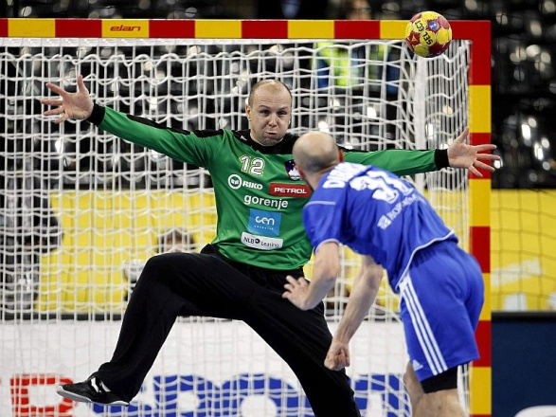
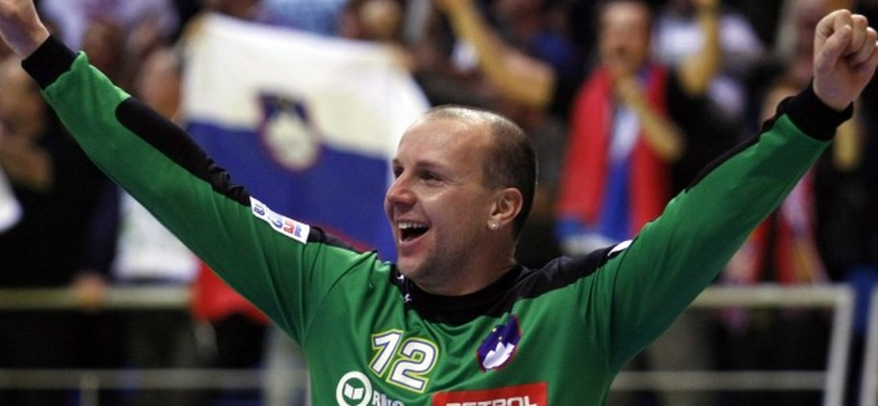
Outstanding athletes from Novo mesto
Gorazd
Škof

Slide 16
DARKO CUJNIK
Outstanding athletes from Novo mesto
Darko was born in Novo mesto on 20 January 1959.
He had always done sports, particularly team sports in his youth, such as football, handball, basketball and volleyball.
When he was 17 he started doing athletics and within a year he was the NationalChampion in the javelin throw.
He won two medals at the Balkan Games and he was a champion many times over in the javelin throw and in all-around athletics competitions.

Slide 17
DARKO CUJNIK
Outstanding athletes from Novo mesto
For ten year he was in the National Team for which he won the silver medal in the Mediterranean Games, the bronze medal in the Balkan Games, both in decathlon, and the bronze medal in the javelin throw in the Mediterranean Games.
He was the first athlete to throw the javelin over 80 metres – exactly 83,56 m – in the former Yugoslavia.
His active sports career was finished in 1987.

Slide 18
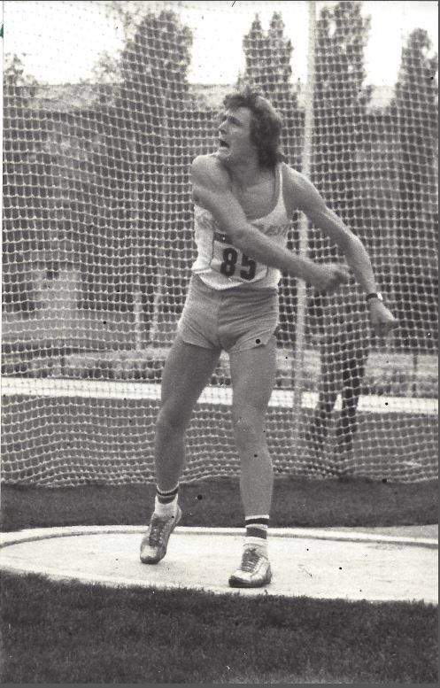
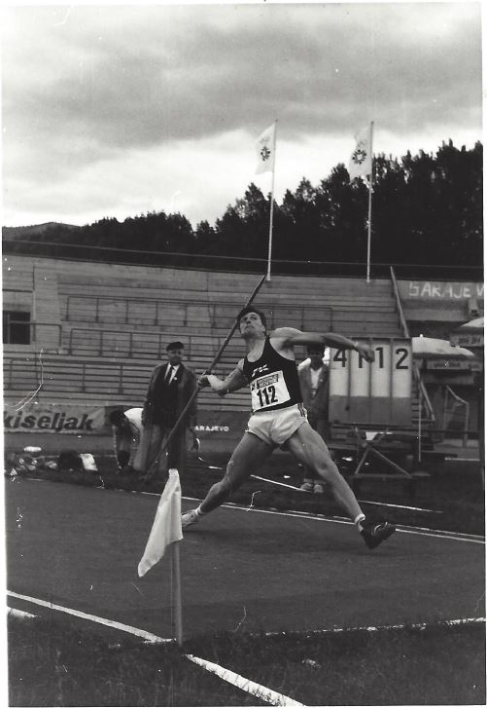
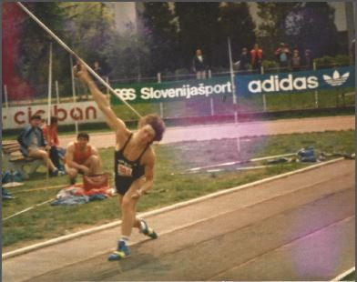
Outstanding athletes from Novo mesto
DARKO
CUJNIK

Slide 19
ROBERT ENGLARO
Outstanding athletes from Novo mesto
He was born on 28 August 1969 in Novo mesto.
Now he is a retired Slovenian football defender.
He was capped 36 times to play for the Slovenian national team between 1992 and 1999.

Slide 20
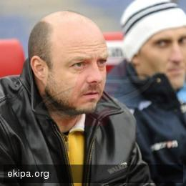
ROBERT ENGLARO
Outstanding athletes from Novo mesto
Besides playing for Slovenian teams, he also played for Italian U. S. Foggia and Atalanta B.C.

Slide 21
JASNA DOKL
Outstanding athletes from Novo mesto
Jasna was born on 9 June 1964 in Novo mesto. She started school in 1971 at Grm Primary School. After finishing grammar school she studied Geography and ethnology.
Many of her relatives did sports. He dad loved sports in general and her mum was a volleyball player. In the family there are record breakers and Olympic athletes.

Slide 22
JASNA DOKL
Outstanding athletes from Novo mesto
Her inspiration for taking up gymnastics was her older sister Maja. When she was five, she started training it twice a week and before the age of 7 she had already won some competitions.
Her very successful career was cut short when she was 16 years old because of a very serious injury.

Slide 23
JASNA DOKL
Outstanding athletes from Novo mesto
When she was 11 she was the junior National Champion.
She took part in two World Gymnastics Championships – in 1978 in France and in 1979 in the USA.

Slide 24
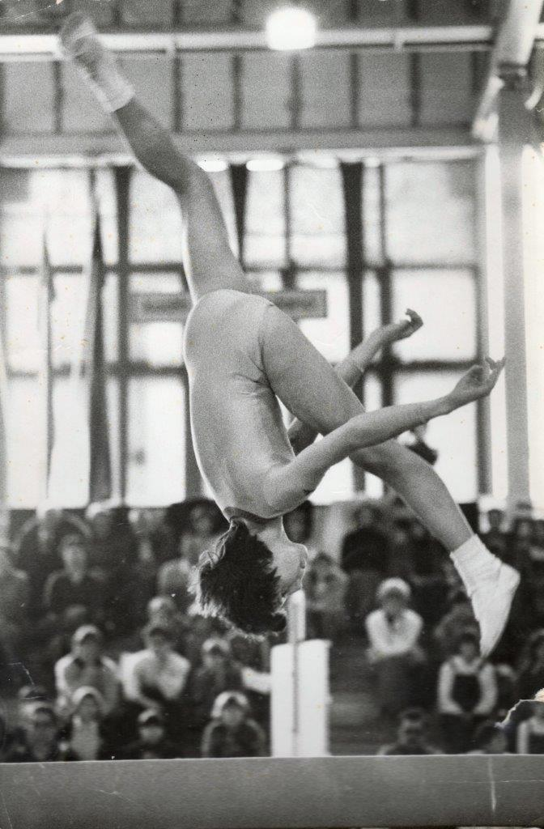
JASNA DOKL
Outstanding athletes from Novo mesto
In the Mediterranean Games she was awarded more than 10 medals and she qualified for the Olympic Games in Moscow which she couldn’t attend due to her injury.

Slide 25
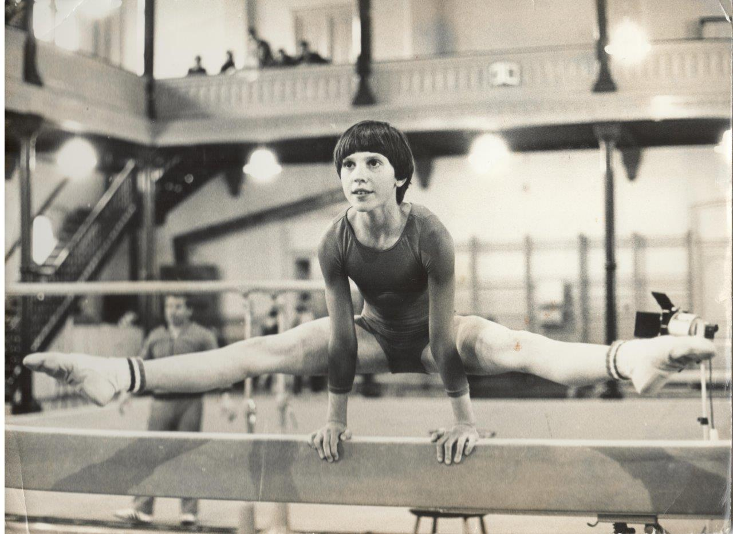
JASNA DOKL
Outstanding athletes from Novo mesto
She achieved her greatest success in the Mediterranean Games in Split in 1979 where she won two medals: gold on balance beam and thus becoming the Mediterranean Champion and silver in floor exercise.

Slide 26
JANA VERNIG
Outstanding athletes from Novo mesto
Jana was born on 1 August 1978 in Novo mesto, Slovenia.
She started playing volleyball very young since her dad was a professional volleyball player himself.
He often took her to his trainings and other players visiting their home made her feel very special.

Slide 27
JANA VERNIG
Outstanding athletes from Novo mesto
Playing volleyball gave her more than just sports medals and achievements – she learnt self respect, compromising, working in a team, making new friends, working hard for her aims in life.
She has in her possession a gold medal, several silver medals and approximately 10 bronze medals.

Slide 28
JANA VERNIG
Outstanding athletes from Novo mesto
When plying in Spain and France she won bronze medals for her clubs.
She was the national team captain many times and she was given an award for being the best sportsperson of Novo mesto four times.

Slide 29
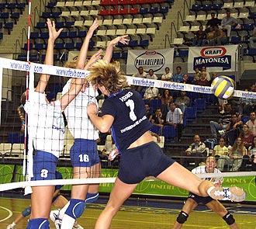
JANA VERNIG
Outstanding athletes from Novo mesto

Slide 30
GORAZD ŠTANGELJ
Outstanding athletes from Novo mesto
He was born on 27 January 1973 in Novo mesto.
He was a professiona road bicycle racer.
He took part in the Athens Olympic Games in 2004.

Slide 31
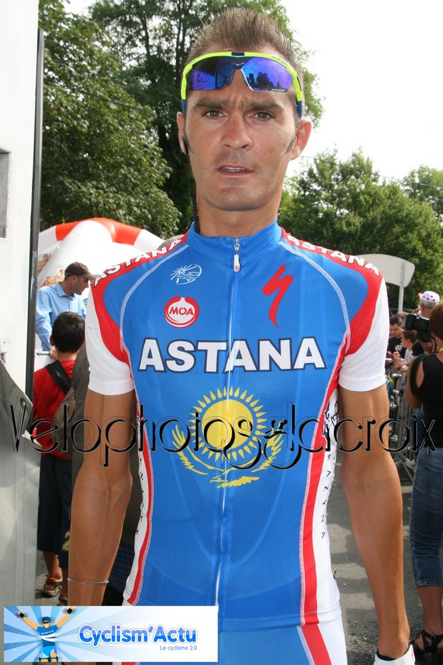
Outstanding athletes from Novo mesto
G
O
A
R
A
Z
D
Š
T
A
N
J
G
E
L
J

Slide 32
JANI BRAJKOVIČ
Outstanding athletes from Novo mesto
He was born in Metlika on 18 December 1983.
He is a road racer cyclist.
In 2004 he won the title the First Slovenian Cycling Champion in Chronometer Race.
In 2005 he became a professional cyclist – his team was Discovery Channel Pro cycling Team.
In 2012 he started racing for the Astana Team.

Slide 33
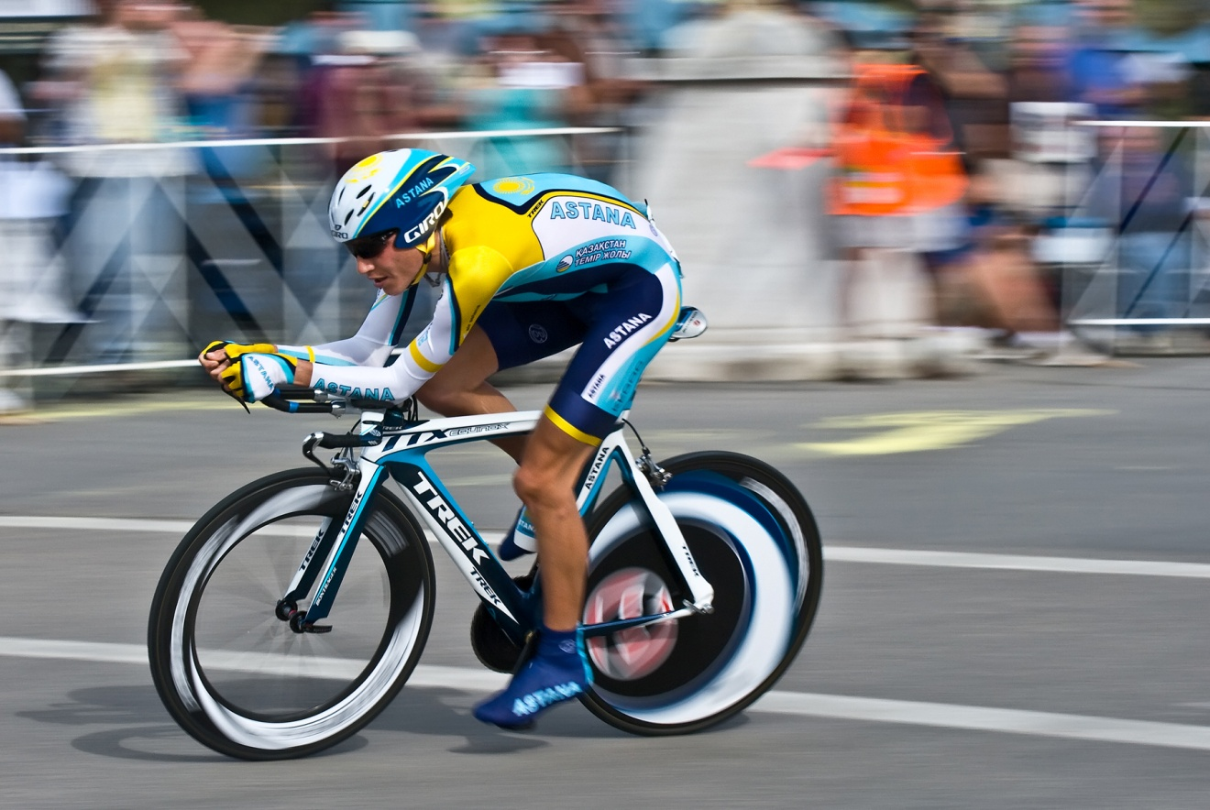
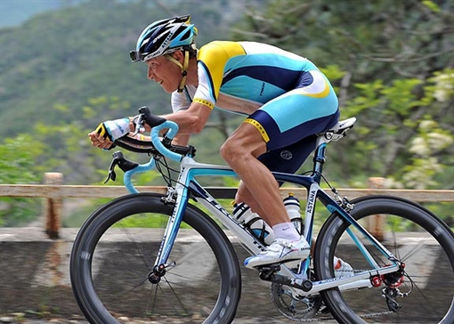
JANI BRAJKOVIČ
Outstanding athletes from Novo mesto

