Slide 1
Potential young
athletes
of Grm Primary School
from Novo mesto,
Slovenia

Slide 2
JAKA PLUT
Potential young athletes of Grm Primary School from Novo mesto, Slovenia
My name is Jaka and I am 13 years old. I come from Novo mesto, Slovenia. My favourite sport is handball. I started with football when I was 7 years old but most of my friends from the neighbourhood played handball so I took it up as well. Now it's something I want to do forever. It's also good for my body, my mind, and my physical condition. When I put on my trainers and step onto the court, touch the ball and score a goal, I feel relaxed and very happy. It's not always easy because we have a lot of intensive trainings during which we run, do push ups, sit ups, squats, and other athletics exercises. During the weekends I play matches with my team.

Slide 3
JAKA PLUT
I have a lot of medals at home from handball matches in Slovenia and also from matches taking place in other countries like Austria and Hungary. I need to play against different clubs in order to become a more experienced player.
Potential young athletes of Grm Primary School from Novo mesto, Slovenia
My dreams are to play for Barcelona Handball Club in Spain, but I know that this is not an easy goal to achieve, so I sometimes have extra training sessions to improve my physical and mental condition.

Slide 4
JAKOV STIPANIČEV
Potential young athletes of Grm Primary School from Novo mesto, Slovenia
My name is Jakov Stipaničev. I was born on 13 April 1999 in Novo mesto. I’ve been playing basketball for 8 years. Basketball is a major part of my life and I really enjoy playing it. I have won a lot of individual and team trophies.

Slide 5
JAKOV STIPANIČEV
Potential young athletes of Grm Primary School from Novo mesto, Slovenia
My most recent achievement is the first place with Krka Basketball Club from my hometown. We won a gold medal for being the best club in the country. I also hope I will win a gold medal for my school, too. This is the last year I can do it since I’m starting a secondary school in September.

Slide 6
JAKOV STIPANIČEV
Potential young athletes of Grm Primary School from Novo mesto, Slovenia
I train a lot. I have basketball practice every day for 2 and half hours. I can rarely do all my homework, but in the end it is all worth it. When I lift that cup, it is the best feeling in the world.

Slide 7
MATEVŽ CIMERMANČIČ
Potential young athletes of Grm Primary School from Novo mesto, Slovenia
I'm Matevž Cimermančič. I'm fourteen and I come from Novo mesto, Slovenia. This September I am going to high school. I am not the kind of person who likes wasting his own time, sitting in front of computer or TV. I prefer being outside. My life has changed a lot when I started doing sports. My parents are very proud of me. They wanted me to train football but I’m not very good at team sports so I started doing athletics instead. Also, my brother Davorin inspired me since he is a successful athlete himself.

Slide 8
MATEVŽ CIMERMANČIČ
Potential young athletes of Grm Primary School from Novo mesto, Slovenia
Not everything is about winning, but it’s also about competing against yourself, conquering your fears and doing the sport you like. That's now part of my life and it would be much harder without it.

Slide 9
MATEVŽ CIMERMANČIČ
Potential young athletes of Grm Primary School from Novo mesto, Slovenia
I started running at the age of ten. I train middle to long distances, so I have five to six training sessions a week. I have become the National Champion three times and I have won 11 medals in the National Championships. I have also competed for Slovenia in an international athletics event in Hungary. My next goal is to run in a big competition, such as the Youth World Championship. If I’m a good student I might get a chance to run for a university somewhere abroad. My ultimate dream is to take part in the Olympic Games along with my younger sister and my older brother.

Slide 10
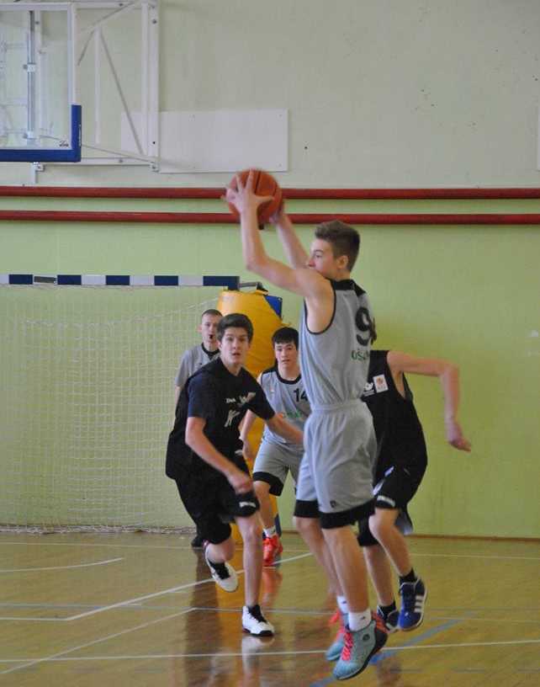
ROK VIDRIH
Potential young athletes of Grm Primary School from Novo mesto, Slovenia
My name is Rok Vidrih, I am from Novo mesto. I have been playing basketball for 5 years. My whole my life revolves around basketball and I love it. I have won a lot of trophies with Krka Basketball Club, with my school team and also some individual awards. Besides winning the Country Tournament three times, my team has also won tournaments in Tuscany (Italy), Zadar (Croatia) and Split (Croatia).

Slide 11
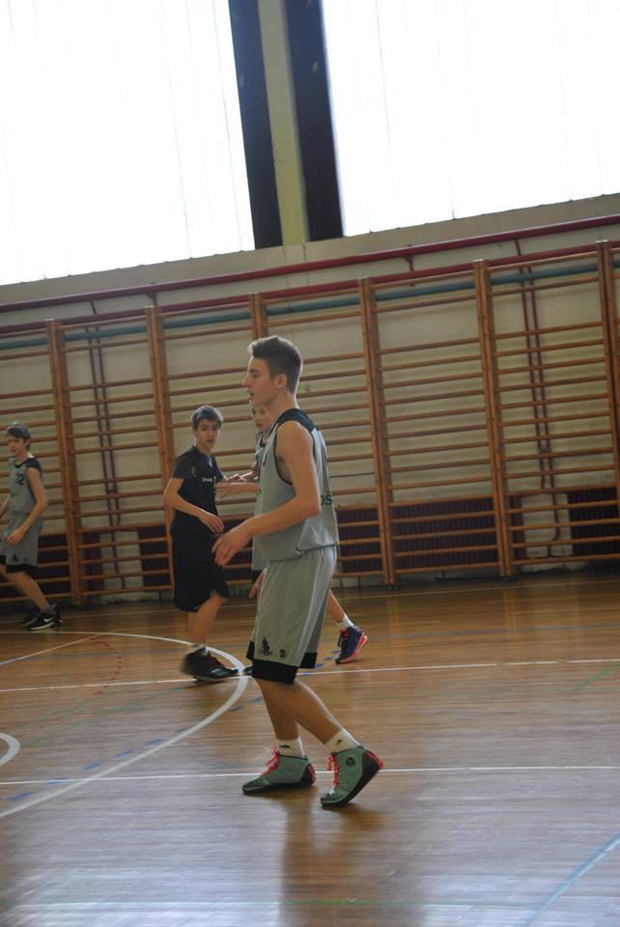
ROK VIDRIH
Potential young athletes of Grm Primary School from Novo mesto, Slovenia
My most memorable moment was when my team won the National Championship this year and I was selected the best player of the tournament. It meant a lot to me and it was like a dream come true. I will never forget it, but the fact is that I’ve worked really hard for it. I practise every day for 2 ½ hours and I have basketball matches every weekend.

Slide 12
ROK VIDRIH
Potential young athletes of Grm Primary School from Novo mesto, Slovenia
Sometimes it is hard work to find the right balance between school work and all the trainings and matches but, luckily, so far I have managed to keep my good grades and enjoy the sport I love. Besides, I am a pretty normal kid. I have a lot of friends; I love music, food, sleeping, swimming and my family. But I have only one favourite, basketball, which is my love. If I could choose my way again, I would choose the same.

Slide 13
MAJA ZAMAN
Potential young athletes of Grm Primary School from Novo mesto, Slovenia
My name is Maja Zaman. I am 12 years old. I train gymnastics. I am very good at it.
It all started when I was a little girl. I was 4 years old. I really liked doing some rolls and other gymnastics elements. So, it was quite natural for me to join a gymnastics club and start training it.

Slide 14
MAJA ZAMAN
Potential young athletes of Grm Primary School from Novo mesto, Slovenia
Through the first three years I made huge progress and was getting better and better at it and when I was in year 4 I won the National Championship. After that I started preparing for bigger and more important competitions. In 2012 I was supposed to take part in my first International Competition in Novi Sad, Serbia, but I unfortunately I didn't go because of my wrist injury.

Slide 15
MAJA ZAMAN
Potential young athletes of Grm Primary School from Novo mesto, Slovenia
My coach is Vesna Stavrev and she is very funny and good.
I'm very good at floor, beam and leap events. But I'm not very good at bars.
My dream in gymnastics is to qualify for the Olympic year 2020.

Slide 16
MAŠA ABUNAR
Potential young athletes of Grm Primary School from Novo mesto, Slovenia
I'm Maša Abunar and I am 15 years old. I live in Novo mesto and I'm in year 9 at Grm Primary School.
I have always loved sports.
In year 4 I started training basketball. I was very excited and I decided to keep going. My team was very successful. We were the National Champions three times.
A lot of times we were among the top three in the country. I also got a lot of other trophies.

Slide 17
MAŠA ABUNAR
Potential young athletes of Grm Primary School from Novo mesto, Slovenia
I really enjoy playing basketball.
In 2013 I also played in the national team.
My goal for the future is to win the BCAA League and the finals for female cadets.
My dream is to became a successful and famous basketball player. I want to play for teams abroad and take part in the Olympic Games.

Slide 18
LAURA MEDLE
Potential young athletes of Grm Primary School from Novo mesto, Slovenia
I’ve been successful in athletics, especially in long jump and triple jump. I have won medals several times in many different competitions. I have also won a gold and silver medal with my school team in the National Championship and a bronze medal for my individual performance.
My name is Laura Medle. I was born on 27 July 1999 in Novo mesto.
I train athletics and I’m a member of Athletics Club Dolenjske Toplice.

Slide 19
LAURA MEDLE
Potential young athletes of Grm Primary School from Novo mesto, Slovenia
Even though I’ve always adored athletics I’ve been training it only since the 7th grade. I train 4 times a week with my trainer but I take care that I put in more practice by myself as well. In the beginning I trained only long jump where my best score is 5.07 metres but I’ve been doing triple jump for almost one year and my best score is 10.50 metres.
My goals in athletics are that I would improve my performance in these two disciplines and be as successful as possible in competitions. I especially wish for the best results in the National Competitions. I know that for achieving my goals I need a lot trainings and good advice from my trainer because I am aware that I need to learn a lot more about the athletics.

Slide 20
LAURA MEDLE
Potential young athletes of Grm Primary School from Novo mesto, Slovenia
I really like those two disciplines, especially the triple jump which I really enjoy doing.
My dream is to represent Slovenia in a very important competition one day and win a gold medal for my country.

